Slide 1

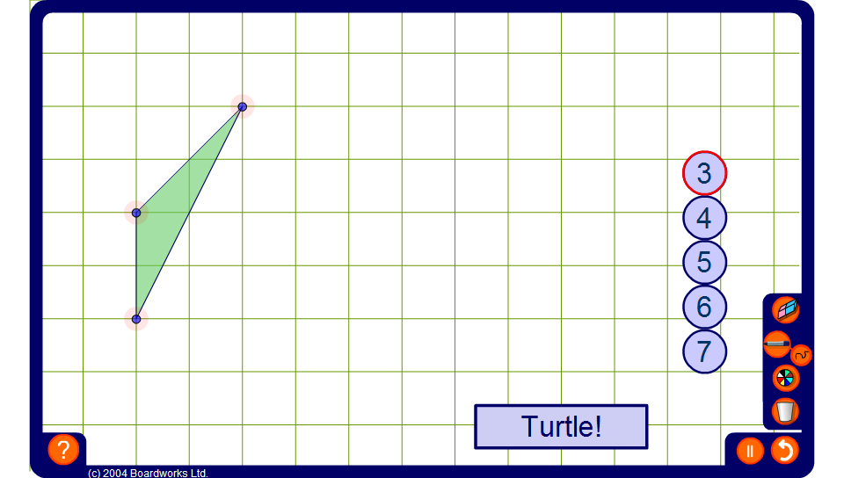


Take Turtle for a walk
Notes:
Use this activity to demonstrate that the sum of the exterior angles in a convex polygon is always 360º.
Select the polygon required by choosing the number of sides and drag the vertices to make a convex polygon.
Hitting the turtle button will make Turtle walk around the outside of the shape.
As Turtle walks around the outside of the shape ask pupils to estimate the size of the next exterior angle.
This activity is ideal for getting pupils to think about the size of exterior angles and would make a good introduction to drawing polygons using Logo.

